Slide 1
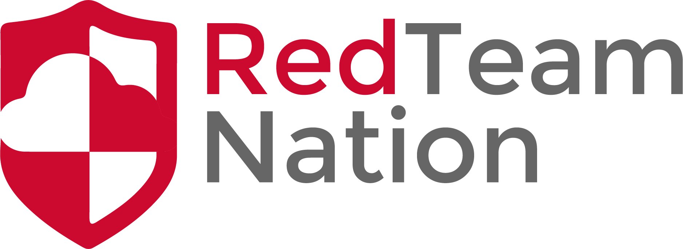
CIA Triangle
CEO/Lead Instructor: Brandon Dennis, OSCP

Slide 2
What is the CIA Triangle?
Common Security Model that is used to guide policies that are put in place
This is also the case when revisiting older policies

Slide 3
The CIA Triangle
Availability
Integrity
Information
Security
Confidentiality

Slide 4
Confidentiality
Controls the access to information
Put in place to ensure only people with correct access has access
Commonly called Authorization
Good example is 2FA

Slide 5
Integrity
This ensures the data accessed is trusted and accurate at all times
Data that is not consistent and inaccurate breaks the triangle
Example is Data Encryption

Slide 6
Availability
If the data is unavailable then it is useless
Common cause of this breaking the triangle is a DDOS attack
Disaster Recovery Plan is crucial for this step so everything can be mitigated and brought up quickly

